Slide 1

On Software Diversification and Deception
A Survey for Completing the PhD
Qualifying Exam Requirement
Adam Duby
aduby@uccs.edu
Software Diversification
Adam Duby

Slide 2
Overview
Research Focus Areas
Introduction
Overview of Program Control Flow and Execution
Threat Model
Compiler Generated Defenses
Operating System Defenses
Booby Trapping Software
Proposed Tasks
The Way Forward
Summary
Software Diversification
Adam Duby

Slide 3
Research Focus Areas
Operating Systems
Compilers
Domain Committee Member
Operating Systems Yanyan Zhuang
Cyber Security Edward Chow
Compilers Qing Yi
Reverse Engineering Jason Upchurch
Cyber Security
Reverse Engineering
Software Exploitation
Software Diversification
Adam Duby

Slide 4
Introduction
Code Reuse Attacks
Types of Code Reuse Attacks:
Function Reuse
Return-Oriented Programming (ROP)
Return-into-libc
Causes
Memory Disclosure (Readable Code Pages)
Predictable Attack Surface
Writable Control Flow Information (Writable Stack, Heap)
Proposed Solutions
Code Diversification
Compiler generated
Operating system generated
Control Flow Integrity
Advanced memory protection
Software Booby Traps
Software Diversification
Adam Duby

Slide 5
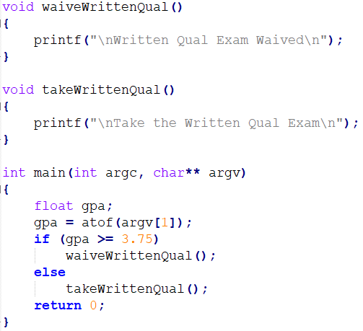
Control Flow
_MAIN
mov gpa, atof(argv[1])
cmp gpa, 3.75
jge _waiveWrittenQual
_waiveWrittenQual
push &data1
call _printf
jmp
_takeWrittenQual
push &data2
call _printf
jmp
ret;
END MAIN
Software Diversification
Adam Duby

Slide 6

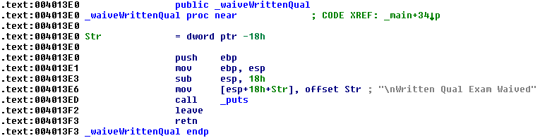
Control Flow Background
.text / .code sections map to RX memory pages
RW Stack
push eip
lea eip, _waiveWrittenQual
0x00401441
Saved Base Pointer
pop eip
eip = 0x00401441
Software Diversification
Adam Duby

Slide 7
Redirected Control Flow
_MAIN
mov gpa, atof(argv[1])
cmp gpa, 3.75
jge _waiveWrittenQual
_waiveWrittenQual
push &data1
call _printf
jmp
_takeWrittenQual
push &data2
call _printf
jmp
_takeWrittenQual
push &data2
call _printf
jmp
ret;
END MAIN
Software Diversification
Adam Duby

Slide 8
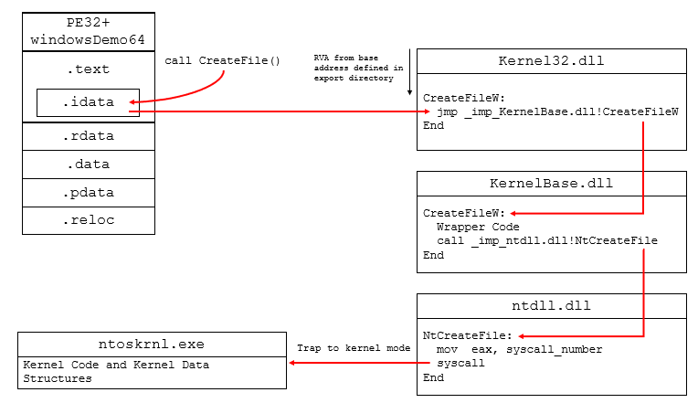
Windows Attack Surface
Software Diversification
Adam Duby

Slide 9
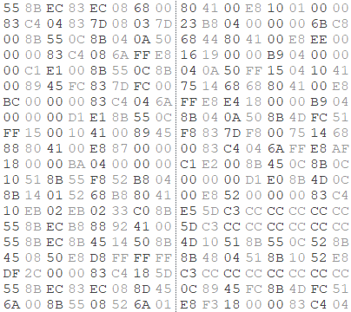
Threat Model
1
2
Software Exploitation
Actions on the Objective
Identify Memory Vulnerability
Stack Overflow
Integer Overflow
Heap
Format String
Code Injection
Shellcode
system(“/bin/sh”)
IP overwrite
Defended with
DEP
Code Reuse
Return-into-libc
Return-Oriented Programming (ROP)
Function Reuse
Untrusted Input
Application
Control-Flow Attack / Runtime Exploit
Software Diversification
Adam Duby

Slide 10
Runtime Control Flow Attacks
Memory Disclosure
Direct memory disclosure – Attacker reads code pages directly
Indirect memory disclosure – Attacker reads code pointers from data pages
Sources of Control Flow Information:
Relocation Tables (.reloc section in PE32)
Linking Information
IAT / INT (PE32)
GOT / PLT (ELF)
Inference from offline analysis
Reverse engineering
Function pointer profiling
Software Diversification
Adam Duby

Slide 11
ROP Gadgets
Schacham (2007, ACM CSS)
Looking for small “gadgets” of code that end in a ret or jmp
Automated tools available to exploit developers
ROP-Chains
Software Diversification
Adam Duby

Slide 12


Code Reuse is Turing Complete
Complex instruction sets offer attackers a buffet of gadgets
Unintended instructions offer attackers even more to choose from
Software Diversification
Adam Duby

Slide 13
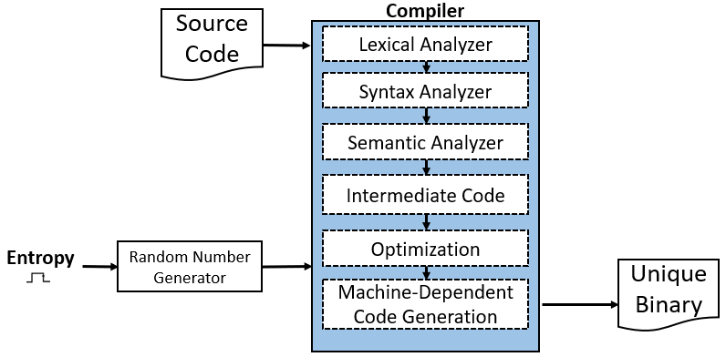
Compiler-Generated Diversity
Generate semantically equivalent, yet syntactically different compiled applications
Code Diversification
Adam Duby

Slide 14
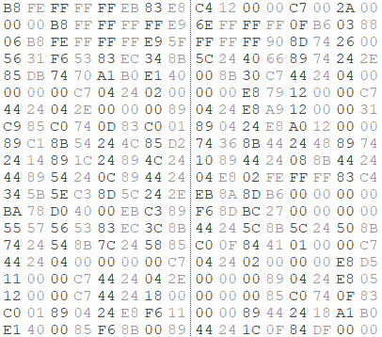
Unique Instances of Equivalent Code
Code Diversification
Adam Duby

Slide 15
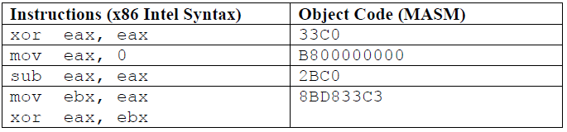
Compiler-Generated Diversity
Randomized NOP insertion
Instruction substitution
Instruction permutation
Function shuffling (argument types, order, calling notations, name mangling)
Layers of indirection (trampolines)
Software Diversification
Adam Duby

Slide 16
Advanced Attacks
Bypass compiler-generated code diversification
Just In Time Code Reuse Attacks (JIT-ROP)
Snow et al. (2013, IEEE S&P)
Runtime gadget chaining
Creates unique ROP-chain for each instance at runtime to achieve malicious endeavor
Makes heavy use of delay loading to achieve arbitrary code execution
Counterfeit Object-Oriented Programming (COOP)
Schuster et al. (IEEE S&P, 2015)
Function reuse via vtables in C++ applications
Address Oblivious Code Reuse (AOCR)
Rudd et al. (NDSS, 2017)
Malicious blocking to pause program execution and observe code layout
Software Diversification
Adam Duby

Slide 17
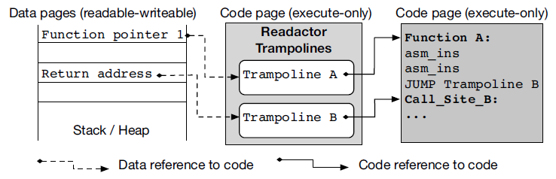
Readactor
Crane et al. (2015, IEEE S&P)
Readactor - Modified LLVM compiler
Defeat JIT-ROP Attacks
Combines code randomization with indirection
Enforces execute-only code pages
Software Diversification
Adam Duby

Slide 18
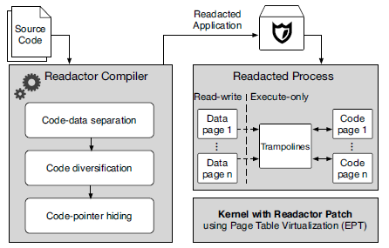
Readactor
Software Diversification
Adam Duby

Slide 19
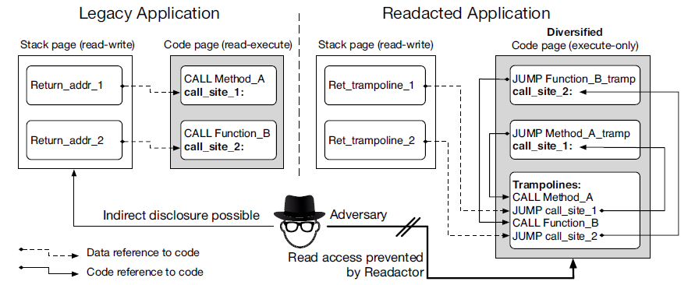
Readactor
Software Diversification
Adam Duby

Slide 20
Readactor++
Readactor did not address the COOP attack
Crane at al. (ACM CSS, 2015) modified Readactor to create Readactor++
Permute tables containing code pointers, including vtables
Introduced additional layer of diversification, unique to each class instantiation
Not resilient against AOCR attacks
Software Diversification
Adam Duby

Slide 21
Operating System Defenses
System Call Randomization
Rauti et al. (ICTS, 2014)
Randomize system call tables
Replace all SYSCALL instruction arguments with new system call
Effective against code injection
Not tested against code reuse
OS Library Obfuscation
Abrath et al. (IEEE SPRO, 2015)
Implement custom loaders to resolve API calls at runtime
RET-Less Kernel Code
Kernel Code Randomization
Software Diversification
Adam Duby

Slide 22
Runtime Randomization Defenses
Runtime rerandomization of return addresses
Isomerron, Davi et al. (NDSS, 2015)
Incurred a large performance overhead
Self Modifying Code for Runtime Rewriting
Chronomorphic Applications, Friedman et al. (ICDS, 2015)
Self modifying code for runtime rewriting
Software Diversification
Adam Duby

Slide 23
Booby Trapped Software
Crane et al. (ACM NSPW, 2013)
Propose booby-trapped software
Alert defenders of an attack in progress
Araujo et al. (ACM CCS, 2014), (ACM USENIX Security, 2015)
Software honey-patches
Deceptive tripwires
Software Diversification
Adam Duby

Slide 24
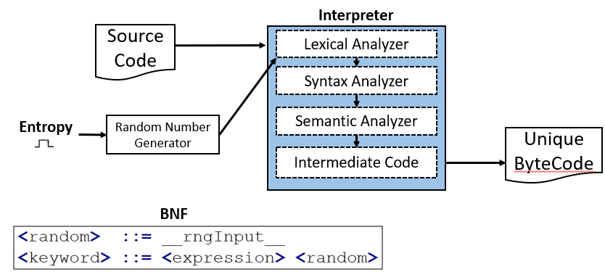
Related Work
Control Flow Integrity (CFI)
New nodes in directed graph throw exceptions
Difficult to implement
Code Pointer Integrity (CPI)
Store all pointers and jmp destinations in a monitored secure region
Challenges such as runtime dynamic linking make this difficult to implement
Language-Generated Diversification
Software Diversification
Adam Duby

Slide 25
Task 1 – Malware Similarity
New threat to malware similarity testing – Code Diversification
Payer at al. (2014) first to address this new threat
Claim that fuzzy hashing and static similarity ineffective against diversified samples
Malware Provenance
Upchurch and Zhou (IEEE MALCON, 2016)
Uses sliding window of opcodes
Thesis: Ineffective against diversified samples
No research addresses source code transformations
Goal: object code agnostic static similarity metrics
Symbol Tables and Linkage information
Binary Lifting to normalized IR
Inspired by David et al. (PLDI, 2017)
Software Diversification
Adam Duby

Slide 26
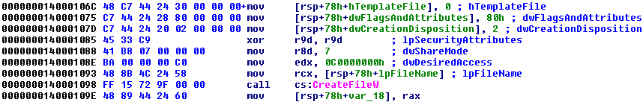
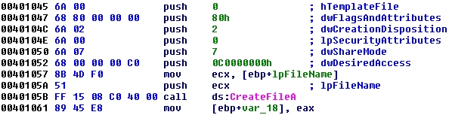
Motivating Example: 32-bit vs 64-bit
Software Diversification
Adam Duby

Slide 27
Task 2 – Runtime CFI
Runtime Control Flow Integrity Checking
Goal: Detect code reuse attacks in progress
Verifying pages mapped to the process address space
Extract static linking information
Libraries, DLLs, APIs from symbol tables and GOT/PLT
Detect deviations in memory mapped files and memory pages
Software Diversification
Adam Duby

Slide 28
Task 3 – Binary Rewriting
Limitation of compiler defenses:
Access to source code
Compiler modifications
Randomize compiled binaries
Relocation tables
Relative offsets
Randomized NOP insertion
Software Diversification
Adam Duby

Slide 29
Task 3 – JIT-MTD
Problem:
Runtime randomization incurs 100% overhead on average
Proposed Solution:
JIT-MTD (term coined by Dr. Chow)
Randomize only as needed
When to randomize
Triggered by booby trap
When task 2 prototype alerts on CFI deviation
How to randomize
Modify the runtime linker to make another pass
Software Diversification
Adam Duby

Slide 30
Self Assessment
Literature Survey
About 150 papers on diversification, code reuse exploitation, and code similarity
Current Skills:
Reverse engineering
Malware analysis
Low level software
Windows memory forensics
OS internals and debugging
Software exploitation
Cyber threat intelligence (CTI)
Areas to Improve:
Compiler internals and binary lifting
LLVM, GCC, Code Generation, Optimization
ROP Compilers
Software Diversification
Adam Duby

Slide 31

The Way Forward
Semester | Tasks
Fall ’17 | Courses: CS5910, CS5220
 | Research: MTD Literature Survey
Spring ’18 | Courses: CS5500, CS5910, CS5950
 | Research: OS Internals and Diversification
 | Prepare and Conduct Oral Qualifier
Summer ’18 | Research: Compilers and IR; CFI via memory mappings and imports
Fall ’18 | Courses: CS6000
 | Prepare and Conduct Proposal
Spring ’19 | Research
Summer ’19
Fall ’19
Spring ’20 | Finalize and conduct final defense
CISSP and Industry Experience Requirement Complete
Written Qualifier Complete (GPA Waiver)
Oral Qualifier Complete
All Coursework Requirements Complete
Proposal Exam Requirements Complete
Final Defense Complete
Software Diversification
Adam Duby

Slide 32
Summary
Code reuse attacks are a serious threat
It’s harder to hit a moving target
Diversification offers a promising premise
Compiler, Operating System
Adversarial Reuse of Diversification and Randomization
Malware similarity problem redefined
Runtime coarse-grained control flow integrity
JIT-MTD
Software Diversification
Adam Duby

Slide 33
On Software Diversification and Deception
A Survey for Completing the PhD Qualifying Exam Requirement
Adam Duby
aduby@uccs.edu
Software Diversification
Adam Duby

